Slide 1
Theorie Bioinformatica
Faster, better, stronger
Bioinformatics and functional genomics (3e) – Jonathan Pevsner (Wiley Blackwell)

Slide 2
De stof komt uit de college presentaties en Jonathan Pevsner "Bioinformatics and Functional Genomics"
(Wiley Blackwell; 3e editie) en een aantal extra papers
(deze worden expliciet in de betrokken colleges genoemd, en zijn te vinden onder "achtergrond").
College | Onderwerp | Hoofdstuk | Pagina's | Opmerkingen
1 | Recap Bioinf 1 | 3-4 | Zie Bioinf1 | Deze stof word t bekend verondersteld!
2 | Next Generation Sequencing | 9 | 377-423 | Niet de source code in je hoofd stampen!
3 | RNASeq | 11 | 479-515,519-528 | Niet de letterlijke R code, niet fig 11.17, 11.18, 11.19, 11.20
4 | Multiple Sequence Alignment | 6 | 205-217, 221-223 | Niet Box 6.3
8/9 | Assembly | 9/15 | 395-398,730-736 | Bestudeer ook de Powerpoint extra!
10 | The Burrough-Wheeler transform for mapping reads | 5
3 | Phylogeny | 7 | 245-289 | Niet Box 7.2,

Slide 3
Presentation content
Chapter 5: pg. 194-197
http://pevsnerlab.kennedykrieger.org/php/powerpoints

Slide 4
Allignment

Slide 5
Sequence alignment for next-generation sequencing
Applications include:
DNA sequencing (e.g. re-sequencing a human genome)
RNAseq (measuring RNA transcript levels)
ChIP-seq (finding protein binding sites)
Methylation studies (genome-wide)

Slide 6
Two approaches to sequence alignment for NGS
[1] Hash Tables
--BLAST seed and extension approach uses
hash table indexing
--spaced seed aligners index the reads or the genome
--programs vary the number of spaced seeds, the read length, memory usage, and sensitivity requirements
--some require multiple seed matches
--some allow gaps
[2] Suffix trees
--Step 1: identify exact matches
--Step 2: build alignments supported by exact matches
--Example: MUMmer (maximal unique matches)
--Example: Bowtie and BWA

Slide 7
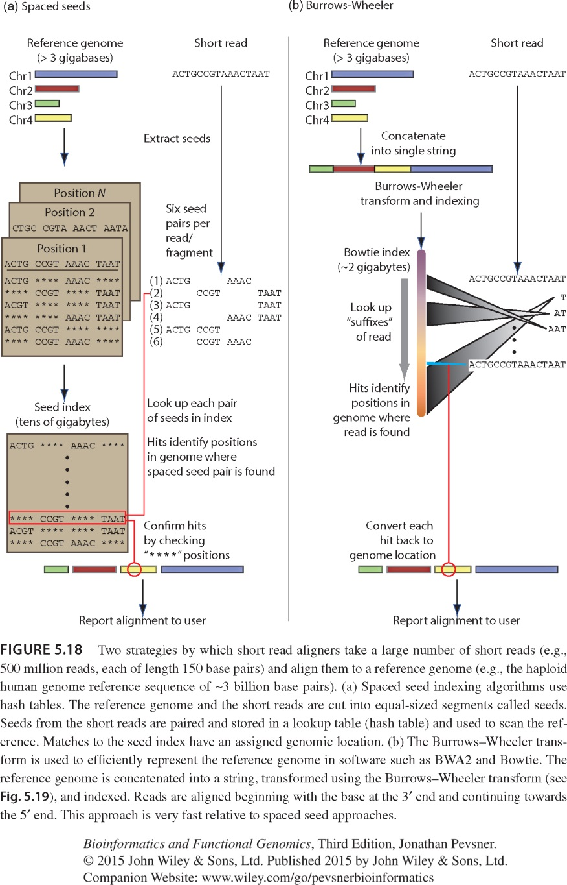
Spaced seed strategy for alignment of many short reads to a large reference genome
MAQ uses spaced seed indexing
Cut the reference genome into “seeds”
Store seeds in look-up table
Cut each read into seeds
Allow up to 2 mismatches in seed pairing reads to the reference
PMID: 19430453

Slide 8
Burrows-Wheeler strategy for alignment of many short reads to a large reference genome
Bowtie uses the Burrows-Wheeler transform (BWT)
Create a memory-efficient representation of the reference genome (need <2 GB memory; MAQ may require >50 GB)
Align a read one base at a time to a BWT transformed genome
Progressively solve the alignment of 1 character, then 2, then 3, etc.
30-fold faster than MAQ

Slide 9
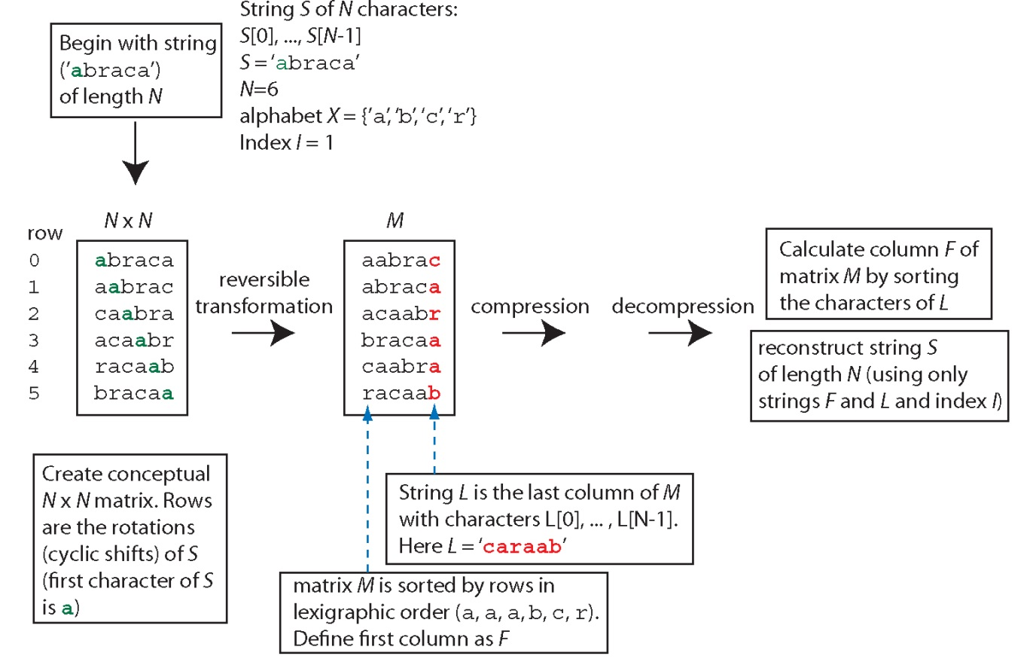
Burrows-Wheeler Transform (BWT): a string (e.g. a reference genome) is compressed then decompressed to facilitate alignment

Slide 10
Perspective
For database searching there continue to be many innovative approaches to improve sensitivity and specificity.
We discussed DELTA-BLAST which is usually the best algorithm for any protein search.
For DNA searches innovative spaced seed approaches have greatly increased search speed.
For next-generation sequence data many algorithms have been introduced to align a vast number of reads (e.g. 1 billion short reads) to a large reference genome (e.g. the ~3 billion base pair human reference genome).

